Slide 1
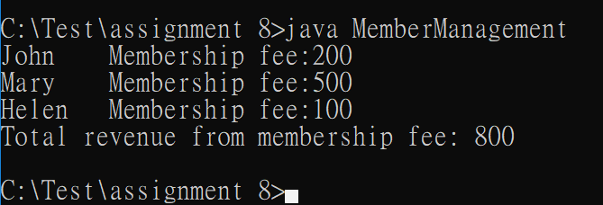
In-class Assignment #8 (array)
A membership system manages a club (Club class) that has a number of members (Member class). To become a member, people have to pay a variant membership fee. Each member (object) has name: String and fee: int data. The membership system uses an array to store up to 20 member objects and can retrieve the total membership fees by calling Club’s totalFees() method (that uses a for loop) to call all of the members’ getFee() method and then returns the total fee amount.
The system has a DOS-based user-interface class called MemberManagement to add some members to the club and retrieve the total amount of membership fees. Implement Club & Member according to MemberManagement class.
public class MemberManagement{
public static void main(String [] args){
Club c = new Club();
c.addMember(new Member("John", 200));
c.addMember(new Member("Mary", 500));
c.addMember(new Member("Helen", 100));
System.out.print(c);
System.out.println("Total revenue from membership fee: "+ c.totalFees());
}}

Slide 2
In-class Assignment #8 (ArrayList)
A membership system manages a club (Club class) that has a number of members (Member class). To become a member, people have to pay a variant membership fee. Each member (object) has name: String and fee: int data. The membership system uses ArrayList to store and can retrieve the total membership fees by calling Club’s totalFees() method that uses a for loop to call all of the members’ getFee() method and then returns the total fee amount.
The system has a DOS-based user-interface class called MemberManagement to add some members to the club and retrieve the total amount of membership fees. Implement Club & Member according to MemberManagement class.
public class MemberManagement{
public static void main(String [] args){
Club c = new Club();
c.addMember(new Member("John", 200));
c.addMember(new Member("Mary", 500));
c.addMember(new Member("Helen", 100));
System.out.print(c);
System.out.println("Total revenue from membership fee: "+ c.totalFees());
}}

